Slide 1
Spotify Artists US Market Analysis
Aleksey Klimchenko

Slide 2

Introduction
Spotify is the largest international music streaming service
Available in 79 countries
Over 365M monthly active users (158M paying subscribers)
>70M songs and podcasts
Spotify song and artist data is available through their web API
Other companies offer paid APIs that provide even more data from multiple sources

Slide 3
Kaggle Datasets Scraped via Spotify Web API
Spotify Tracks Dataset (v15)
600k Tracks (not used)
1.1M Artists
Contains only US market data
Last Updated 04/18/2021
Source: https://www.kaggle.com/yamaerenay/spotify-dataset-19212020-160k-tracks
Author: Yamac Eren Ay
Spotify Artists Data (v3)
125 different markets (countries)
Nearly 100k artists per market
No track data
Last Updated 04/18/2021
Source: https://www.kaggle.com/yamaerenay/spotify-artists-dataset-19222021
Author: Yamac Eren Ay

Slide 4
What is the relationship between an Artist’s popularity on Spotify and their follower count?
Should Artists focus on acquiring followers, or acquiring popularity?

Slide 5
Artist Features
Pulled from Spotipy, the Spotify Web API
id - id of artist, is unique
followers - number of followers of artist at that time
name - name of artist
popularity - popularity of artist
genres - list of genres associated with the artist
“The artist’s popularity is calculated from the popularity of all the artist’s tracks.”

Slide 6
Spotify Artist Data Cleaning
Removing duplicate data and ensuring artist uniqueness
Some artists have multiple entries
Subset the data to simplify later analysis
For US market, only keep artists with popularity above 10 and cut the data into nine interval ranges

Slide 7
Artists in the US Market: EDA
Useful metrics:
Popularity Distribution of Artists*
Average number of followers within a popularity interval*
Spread of followers within a popularity interval*
*Only using artists with popularity score >10, or ~30% of the data

Slide 8
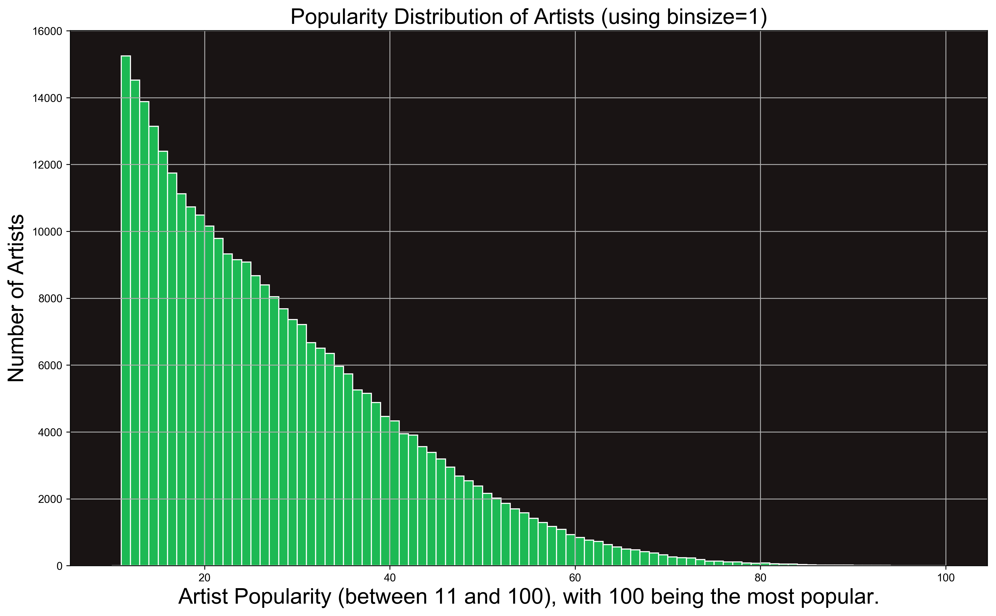
Popularity Distribution of Artists

Slide 9
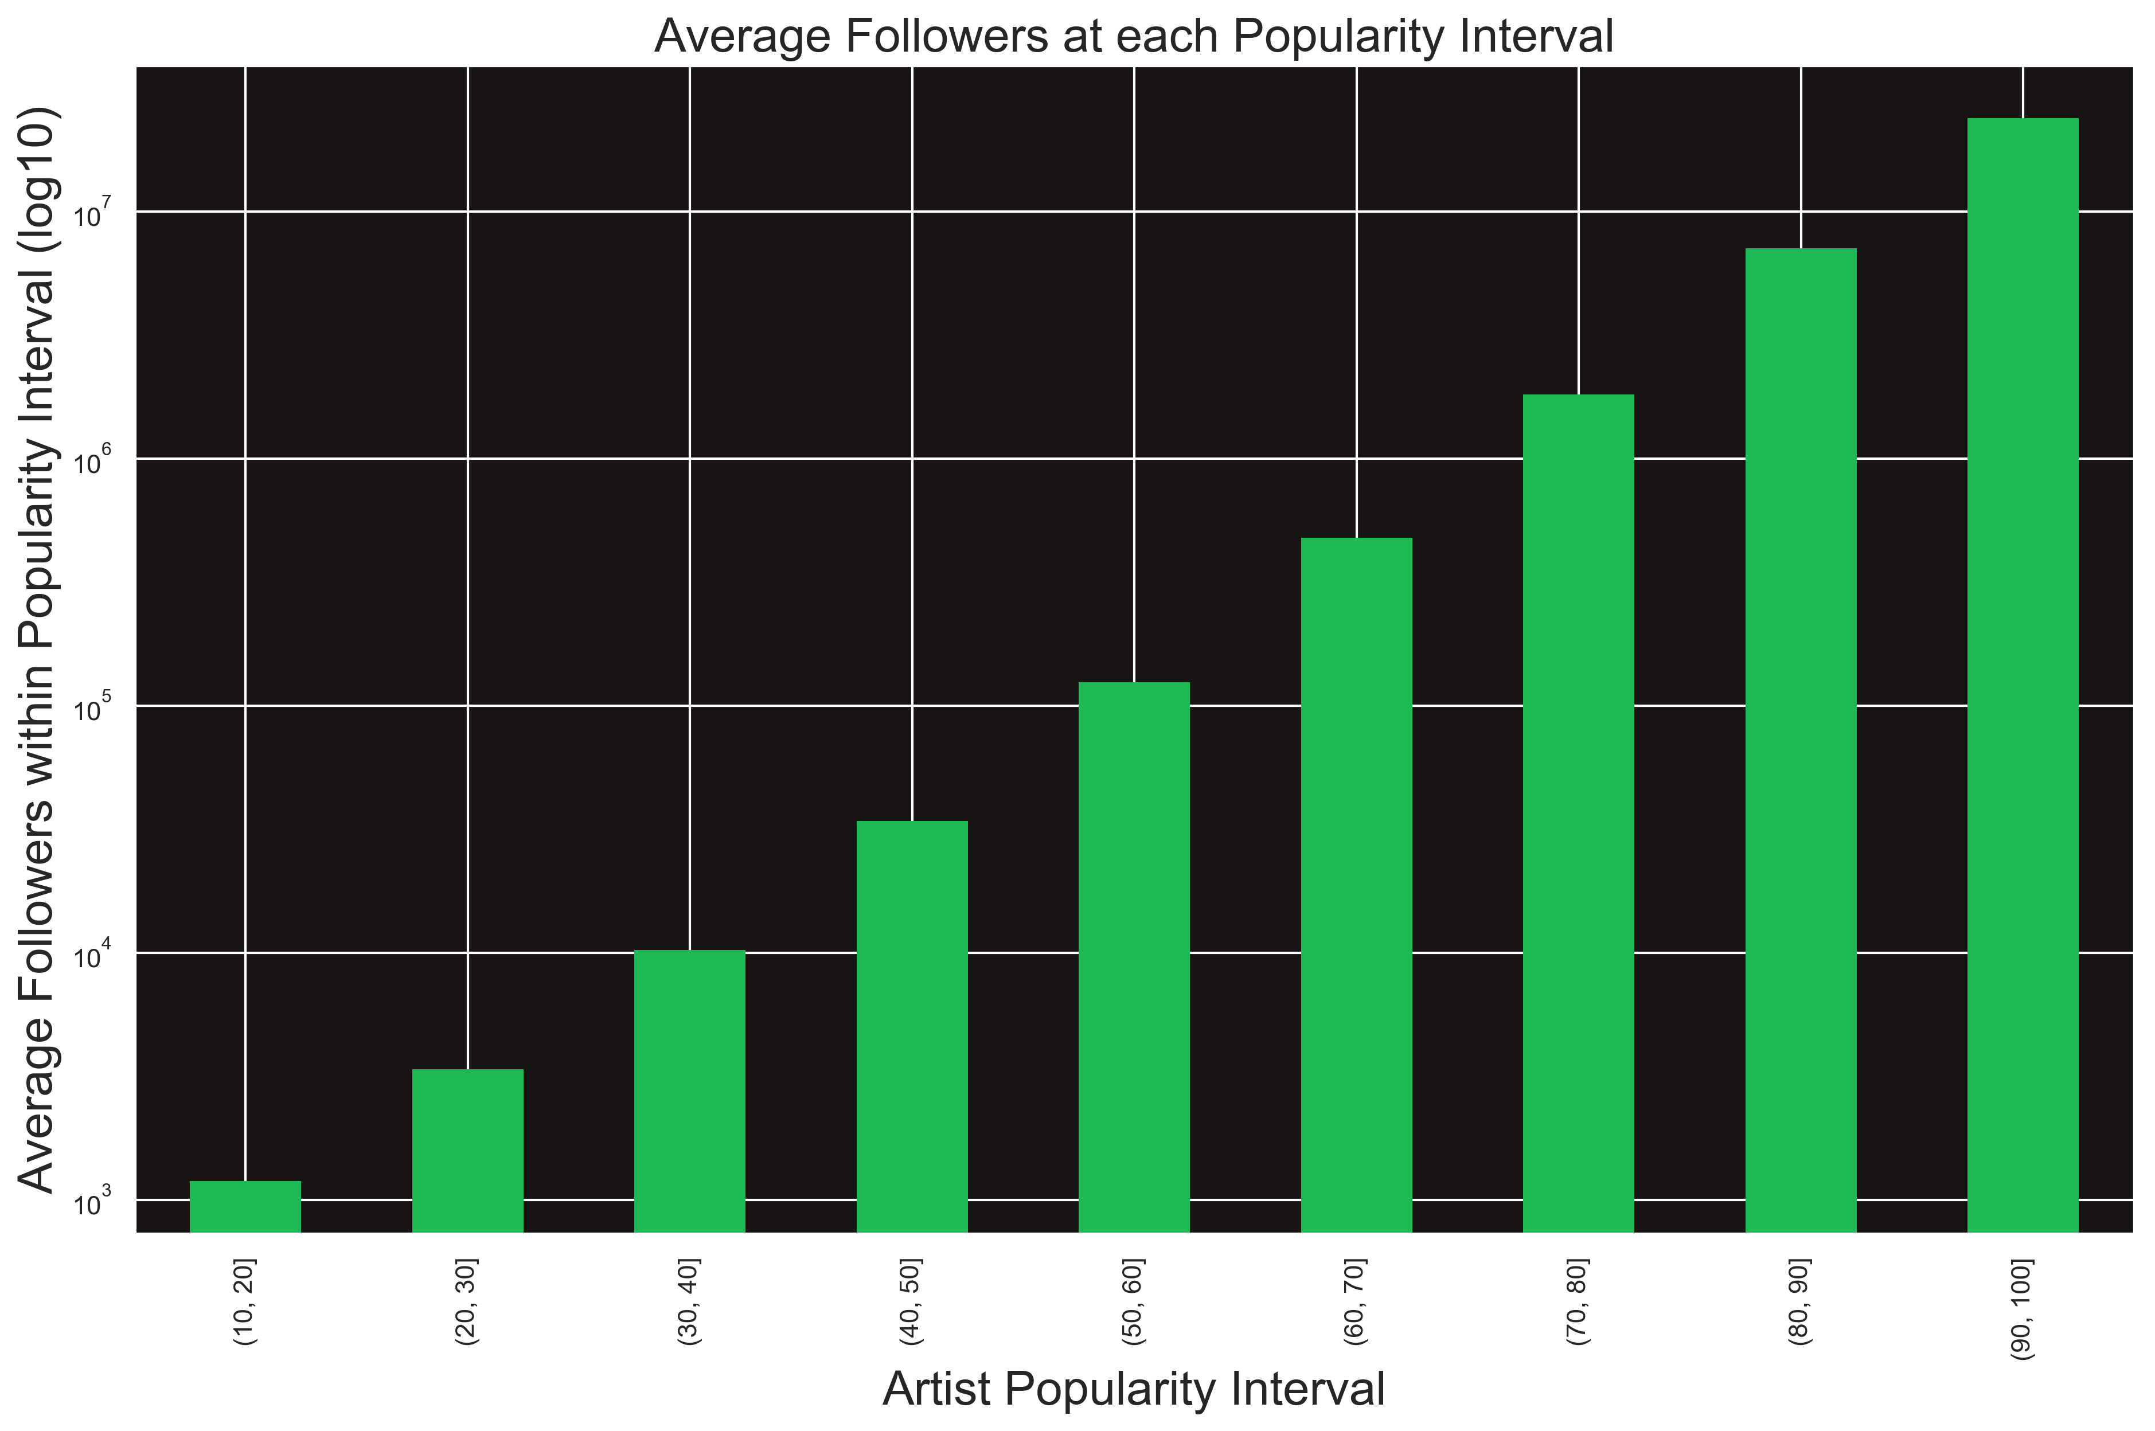
Average Number of Followers

Slide 10
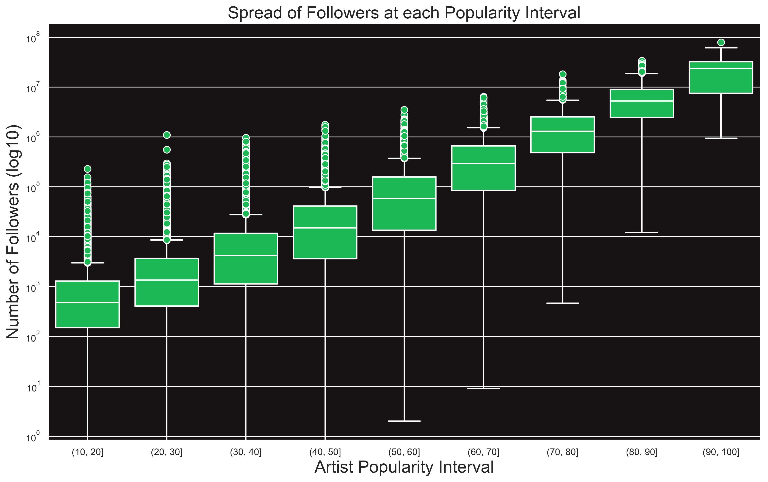
Spread of Follower Count

Slide 11
Conclusion
There is clearly a logarithmic relationship between an artist’s popularity and their follower count
Some artists at lower popularity levels have more followers than artists at higher popularity levels
Artists should probably focus on building popularity, meaning focusing on getting more of their songs played.

Slide 12
Future Analysis
Better housekeeping: create better structure for popularity intervals and/or remove outliers
Explore relationship between artist genre and artist popularity/following
Explore popularity of top US artists in foreign markets
Visualize the location of foreign followers for top US artists

